Slide 1
Community Development Department
Best Practices for
Public Service Grants
June 12, 2025

Slide 2
The Stats Behind Wausau
Located in North Central WI
Wausau Population: 40,000
MSA Principal City
Metro Population:138,067
Median Age: 41.2
Median Income: $76,185
Median Home Value: $205,500
Median Poverty Rate: 8.91%

Slide 3
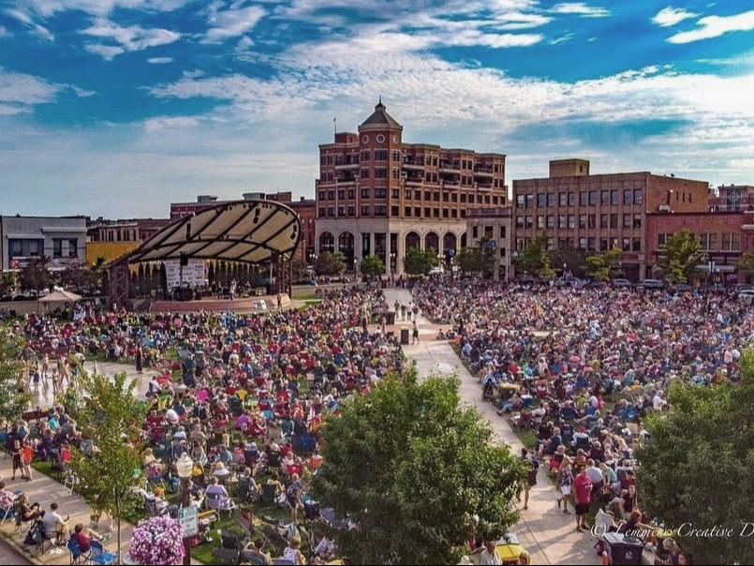
Wausau’s CDBG Statistics
Allocations over the past 4 years have ranged from $597,000 to $647,000.
2025 allocation is $578,864, a 2% decrease from 2024, or about $22,000 less.
Public Service Activities: 10–15% of annual allocation (max $86,800/yr).
On average, 4 to 6 Public Service Activities receive funding annually.
Internal Public Facilities are funded each year, with occasional support for external projects.

Slide 4
Public Service Subrecipients
CDBG Application Process for New Applicants / New Non-Profits
MEET
With representative(s) of organization PRIOR them submitting a CDBG Application
DISCUSS
INFORM
Representative(s) of the requirements & responsibilities if awarded CDBG Funding
The organization’s services and their potential request for funding
VISIT
The organization’s facility to see and experience daily operations
Required Policies
Unique Identification Number
Reporting Requirements
Documentation of Beneficiary Income & Demographics
Documentation Required with Reimbursement Requests

Slide 5
Application Submission: Required Documents
Articles of Incorporation
Bylaws
Tax Exempt Determination
Non-Discrimination Policy
Organizational Chart
Board of Directors
(with term dates)
Certificate of Insurance
Grant Staff Contact Information

Slide 6
Repeat Subrecipient Review
Prior year funding fully spent per agreement?
Reports submitted on time?
Documentation provided as requested?
Funds spent timely?
Effective organization during monitoring?
Meeting record retention rules?

Slide 7
Citizens Advisory Committee
Share priority areas from the 5-Year Consolidated Plan.
Update on upcoming or potential projects.
Encourage members to share info on new local agencies.
Include a Council member to help advocate for approvals.
Leverage members connected to foundations for referrals.
Educate on subrecipient reporting, monitoring, and staff time involved.

Slide 8
Funding Recommendations
Establish
A Minimum Grant Amount
Evaluate whether awards under $5,000 are practical
Align
Awards with Staffing Capacity
Match the number of subrecipients to available staff.
Assess
Multi-Year Commitments
Decide if continued funding for the same organization
Avoid
Funding One-Time Items
Funding specific items (tangible assets) can complicate
over multiple years aligns with program goals.
tracking and compliance.
for both staff and subrecipients.

Slide 9
Now What? Post-Award Essentials
Hold
A Pre-Award Meeting
Review the subrecipient agreement, reporting requirements,
Provide
Tools for Success
Share templates for invoices, timesheets, intake forms, and income verification—especially helpful for new organizations.
Clarify
Key Timelines
Explain when expenditures can begin and how to submit reimbursement requests.
Maintain
Open Communication
Are funds not being spent as expected?
Are service numbers falling short?
Are reports not submitted on time?
Address issues early to stay on track.
data collection expectations, and monitoring process.

Slide 10
Documentation Requirements
Subrecipients must keep accurate, up-to-date records of how CDBG funds are used, retained for 3 years after the final audit.
Organize records into the following categories:
Application
Completed application and supporting materials
Application-related correspondence
Current list of Board of Directors with term dates
Grant Agreement
Signed contract and any amendments
Related correspondence and conditions
Contact info for grant administrators
Program Procedures
Copies of forms, brochures, and materials used
Financial Management
Accounting records (general ledger, entries)
Source documents (invoices, payroll, receipts)
Deposit slips, bank records, canceled checks
Match documentation (if applicable)
Property acquisition/disposition records (if applicable)
Proof of insurance and bonding

Slide 11
Documentation Requirements Continued
Activity Reports
Copies of all required reports
Equal Opportunity / Fair Housing
Affirmative Action Plan & compliance documentation
Demographic data on program participants
Efforts to use WMB vendors
Fair housing activity records (if applicable)
Employment data for CDBG-funded activities
Section 504
If 15+ employees: designate coordinator, notify participants & evaluate compliance
Monitoring
Reports, findings, responses, & clearance documentation
Program Close-Out / Audit
Final report and audit documents
General Correspondence
Other relevant emails or letters not categorized above

Slide 12
Documentation Requirements Continued
Individual Project Files Maintain a separate file for each assisted household. Use this as a checklist to ensure all required documents are included.
Required Documentation:
Completed application with name, address, household size, income, demographics, target area & need
Release of Information form
Income verification (for low-mod activities)
Proof of services provided & completion status
Follow-up documentation
Record of other assistance (type, date, provider)*
Housing quality standards documentation*
Financial records of assistance*
Amount, purpose, date, & frequency
If assistance is a loan, include:
Loan Agreement & Terms
Security
Right of Rescission
Truth in Lending
*Required only for direct financial assistance activities.

Slide 13
Templates & Tools Share & Support
Affirmative Action Policy
Anti-Discrimination Policy
Conflict of Interest Policy
Fair Housing Policy
Procurement Policy
Beneficiary Data & Intake Forms
Reimbursement Invoices
Release of Information Forms
Timecards
(Biweekly vs Monthly)

Slide 14
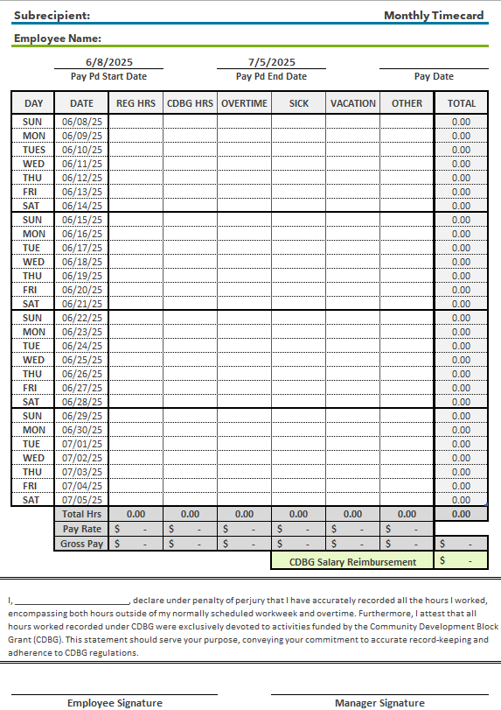
Timecard Template

Slide 15
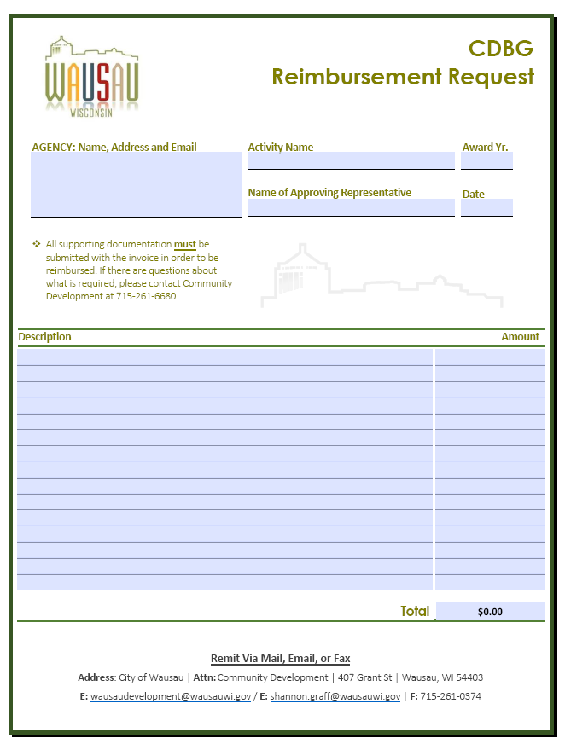
Invoice Template

Slide 16
Monitoring Process: Follow the Money
Pre-Monitoring
Schedule visit 4-6 weeks
Monitoring Steps
Review Files & Records
Send checklist to guide Subrecipient
Review past performance if previously funded
Review reports submitted for timeliness & accuracy
Compare goals vs. outcomes
Client Files (income eligibility, services received)
Financial Records (invoices, timesheets, etc.)
Program Materials (intake forms, outreach material)
Interview Staff (if needed) to assess knowledge of CDBG requirements
Evaluate recordkeeping, intake process, internal controls, etc.
Review for compliance with eligible activities, national objective, procurement, fair housing & equal opportunity, ADA & record retention
Post-Monitoring
Send formal monitoring letter summarizing visit noting any concerns or findings requiring corrective action
Follow-up to ensure findings are resolved
Retain all relevant documents & correspondence from monitoring
Schedule follow-up if needed

Slide 17
High Priorities: What Could Go Wrong?
High-priority need identified, but no agencies apply for funding
Multiple applications for a priority area, but none are strong or complete
Funded agency is not meeting performance expectations
Funded agency is not spending funds as proposed

Slide 18
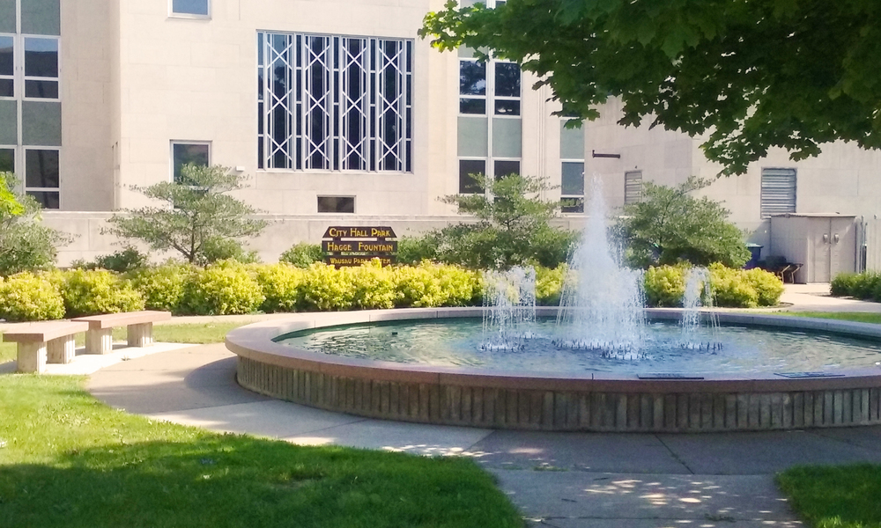
Questions
Tammy Stratz
Community Development Manager
407 Grant St. | Wausau, WI
715-261-6682
tammy.stratz@wausauwi.gov

